Slide 1
Algorithm Analysis and Design Linear Time Sorting (Radix Sort and Bucket Sort)
Lecture -22

Slide 2
Linear Time Sorting (Radix Sort)

Slide 3
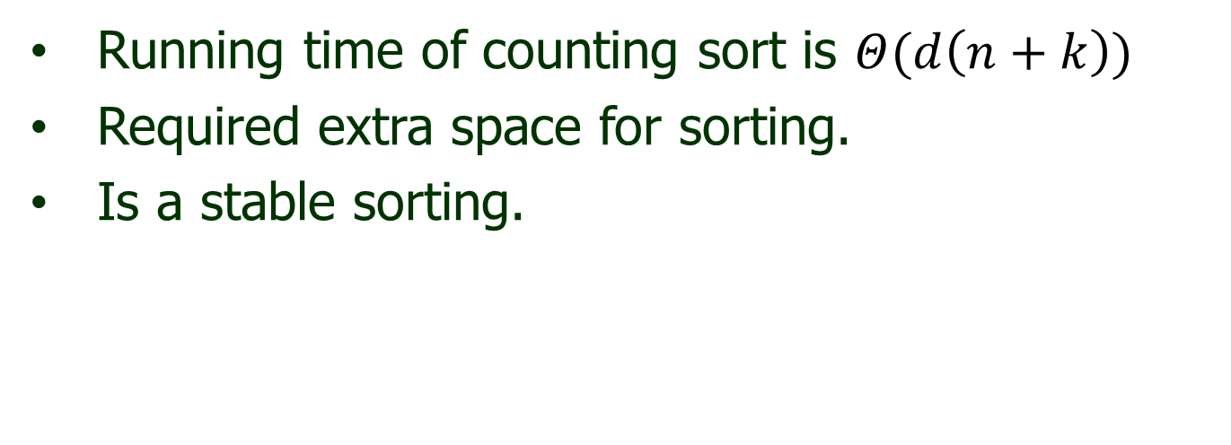
Overview
Running time of counting sort is $Θ(d\left(n+k\right))$
Required extra space for sorting.
Is a stable sorting.

Slide 4
Radix Sort
Radix sort is non comparative sorting method
Two classifications of radix sorts are least significant digit (LSD) radix sorts and most significant digit (MSD) radix sorts.
LSD radix sorts process the integer representations starting from the least digit and move towards the most significant digit. MSD radix sorts work the other way around.

Slide 5
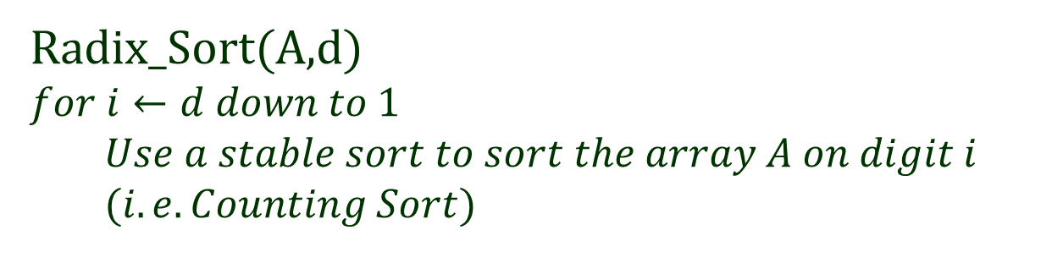
Radix Sort (Algorithm)
Radix_Sort(A,d)
$$for i←d down to 1$$
$$Use a stable sort to sort the array A on digit i$$
$$(i.e. Counting Sort)$$

Slide 6
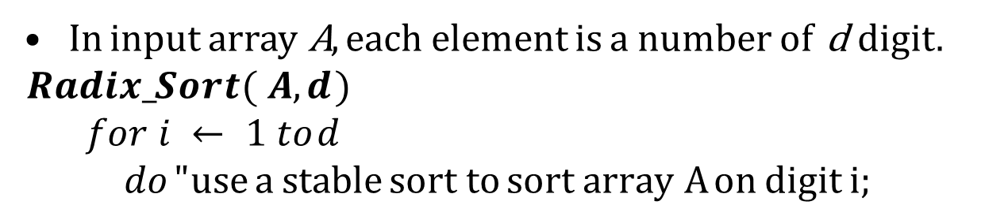
Radix Sort
In input array A, each element is a number of d digit. $Radix_Sort( A, d )$
$$for i ← 1 to d$$
$$do " use a stable sort to sort array A on digit i;$$
329
457
657
839
436
720
355

Slide 7
Radix Sort
In input array A, each element is a number of d digit. $Radix_Sort( A, d )$
$$for i ← 1 to d$$
$$do " use a stable sort to sort array A on digit i;$$
329 |  | 720
457 |  | 355
657 |  | 436
839 |  | 457
436 |  | 657
720 |  | 329
355 |  | 839

Slide 8
Radix Sort
In input array A, each element is a number of d digit. $Radix_Sort( A, d )$
$$for i ← 1 to d$$
$$do " use a stable sort to sort array A on digit i;$$
329 |  | 720 |  | 720
457 |  | 355 |  | 329
657 |  | 436 |  | 436
839 |  | 457 |  | 839
436 |  | 657 |  | 355
720 |  | 329 |  | 457
355 |  | 839 |  | 657

Slide 9
Radix Sort
In input array A, each element is a number of d digit. $Radix_Sort( A, d )$
$$for i ← 1 to d$$
$$do " use a stable sort to sort array A on digit i;$$
329 |  | 720 |  | 720 |  | 329
457 |  | 355 |  | 329 |  | 355
657 |  | 436 |  | 436 |  | 436
839 |  | 457 |  | 839 |  | 457
436 |  | 657 |  | 355 |  | 657
720 |  | 329 |  | 457 |  | 720
355 |  | 839 |  | 657 |  | 839

Slide 10
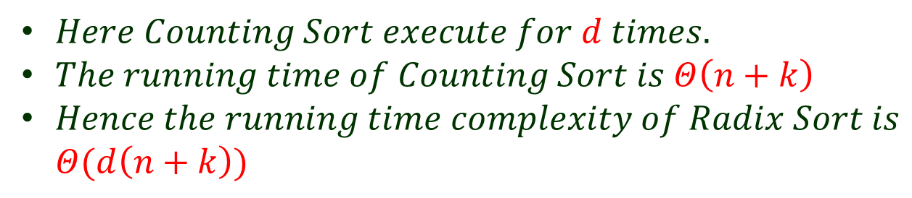
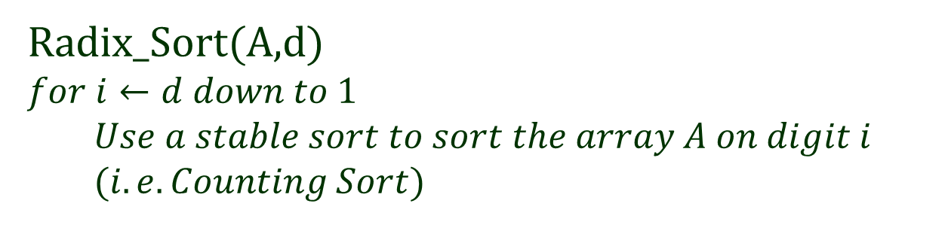
Radix Sort (Analysis)
Radix_Sort(A,d)
$$for i←d down to 1$$
$$Use a stable sort to sort the array A on digit i$$
$$(i.e. Counting Sort)$$
$Here Counting Sort execute for d times.$
$The running time of Counting Sort is Θ\left(n+k\right)$
$Hence the running time complexity of Radix Sort is$
$Θ(d\left(n+k\right))$

Slide 11
Linear Time Sorting (Bucket Sort)

Slide 12
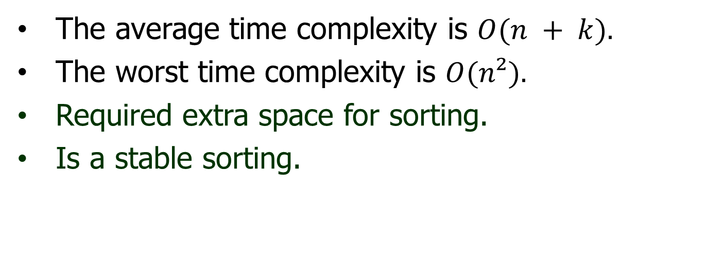
Overview
The average time complexity is $O(n + k).$
The worst time complexity is $O(n²).$
Required extra space for sorting.
Is a stable sorting.

Slide 13
Bucket Sort
Bucket sort is a comparison sort algorithm that operate on elements by dividing them into different bucket and return the result.
Buckets are assigned based on each element’s search key.
A the time of returning the result, First concatenate each bucket one by one and then return the result in a single array.

Slide 14
Bucket Sort
Some variations
Make enough buckets so that each will only hold one element, use a count for duplicates.
Use fewer buckets and then sort the contents of each bucket.
The more buckets you use, the faster the algorithm will run but it uses more memory.

Slide 15
Bucket Sort
Time complexity is reduced when the number of items per bucket is evenly distributed and it is closed to one item per bucket.
As buckets require extra space, This algorithm trading increased space consumption for a lower time complexity.
In general, Bucket Sort beats all other sorting techniques in time complexity but can require a huge of space.

Slide 16
Bucket Sort
One Value per bucket:
4 | 2 | 1 | 2 | 0 | 3 | 2 | 1 | 4 | 0 | 2 | 3 | 0
0 |  | 1 |  | 2 |  | 3 |  | 4

Slide 17
Bucket Sort
One Value per bucket:
4 | 2 | 1 | 2 | 0 | 3 | 2 | 1 | 4 | 0 | 2 | 3 | 0
 |  |  |  |  |  |  |  | 4
0 |  | 1 |  | 2 |  | 3 |  | 4

Slide 18
Bucket Sort
One Value per bucket:
4 | 2 | 1 | 2 | 0 | 3 | 2 | 1 | 4 | 0 | 2 | 3 | 0
 |  |  |  | 2 |  |  |  | 4
0 |  | 1 |  | 2 |  | 3 |  | 4

Slide 19
Bucket Sort
One Value per bucket:
4 | 2 | 1 | 2 | 0 | 3 | 2 | 1 | 4 | 0 | 2 | 3 | 0
 |  | 1 |  | 2 |  |  |  | 4
0 |  | 1 |  | 2 |  | 3 |  | 4

Slide 20
Bucket Sort
One Value per bucket:
4 | 2 | 1 | 2 | 0 | 3 | 2 | 1 | 4 | 0 | 2 | 3 | 0
 |  |  |  | 2
 |  | 1 |  | 2 |  |  |  | 4
0 |  | 1 |  | 2 |  | 3 |  | 4

Slide 21
Bucket Sort
One Value per bucket:
4 | 2 | 1 | 2 | 0 | 3 | 2 | 1 | 4 | 0 | 2 | 3 | 0
 |  |  |  | 2
0 |  | 1 |  | 2 |  |  |  | 4
0 |  | 1 |  | 2 |  | 3 |  | 4

Slide 22
Bucket Sort
One Value per bucket:
4 | 2 | 1 | 2 | 0 | 3 | 2 | 1 | 4 | 0 | 2 | 3 | 0
 |  |  |  | 2
0 |  | 1 |  | 2 |  | 3 |  | 4
0 |  | 1 |  | 2 |  | 3 |  | 4

Slide 23
Bucket Sort
One Value per bucket:
4 | 2 | 1 | 2 | 0 | 3 | 2 | 1 | 4 | 0 | 2 | 3 | 0
 |  |  |  | 2
 |  |  |  | 2
0 |  | 1 |  | 2 |  | 3 |  | 4
0 |  | 1 |  | 2 |  | 3 |  | 4

Slide 24
Bucket Sort
One Value per bucket:
4 | 2 | 1 | 2 | 0 | 3 | 2 | 1 | 4 | 0 | 2 | 3 | 0
 |  |  |  | 2
 |  | 1 |  | 2
0 |  | 1 |  | 2 |  | 3 |  | 4
0 |  | 1 |  | 2 |  | 3 |  | 4

Slide 25
Bucket Sort
One Value per bucket:
4 | 2 | 1 | 2 | 0 | 3 | 2 | 1 | 4 | 0 | 2 | 3 | 0
 |  |  |  | 2
 |  | 1 |  | 2 |  |  |  | 4
0 |  | 1 |  | 2 |  | 3 |  | 4
0 |  | 1 |  | 2 |  | 3 |  | 4

Slide 26
Bucket Sort
One Value per bucket:
4 | 2 | 1 | 2 | 0 | 3 | 2 | 1 | 4 | 0 | 2 | 3 | 0
 |  |  |  | 2
0 |  | 1 |  | 2 |  |  |  | 4
0 |  | 1 |  | 2 |  | 3 |  | 4
0 |  | 1 |  | 2 |  | 3 |  | 4

Slide 27
Bucket Sort
One Value per bucket:
4 | 2 | 1 | 2 | 0 | 3 | 2 | 1 | 4 | 0 | 2 | 3 | 0
 |  |  |  | 2
 |  |  |  | 2
0 |  | 1 |  | 2 |  |  |  | 4
0 |  | 1 |  | 2 |  | 3 |  | 4
0 |  | 1 |  | 2 |  | 3 |  | 4

Slide 28
Bucket Sort
One Value per bucket:
4 | 2 | 1 | 2 | 0 | 3 | 2 | 1 | 4 | 0 | 2 | 3 | 0
 |  |  |  | 2
 |  |  |  | 2
0 |  | 1 |  | 2 |  | 3 |  | 4
0 |  | 1 |  | 2 |  | 3 |  | 4
0 |  | 1 |  | 2 |  | 3 |  | 4

Slide 29
Bucket Sort
One Value per bucket:
4 | 2 | 1 | 2 | 0 | 3 | 2 | 1 | 4 | 0 | 2 | 3 | 0
 |  |  |  | 2
0 |  |  |  | 2
0 |  | 1 |  | 2 |  | 3 |  | 4
0 |  | 1 |  | 2 |  | 3 |  | 4
0 |  | 1 |  | 2 |  | 3 |  | 4

Slide 30
Bucket Sort
One Value per bucket:
4 | 2 | 1 | 2 | 0 | 3 | 2 | 1 | 4 | 0 | 2 | 3 | 0
 |  |  |  | 2
0 |  |  |  | 2
0 |  | 1 |  | 2 |  | 3 |  | 4
0 |  | 1 |  | 2 |  | 3 |  | 4
0 |  | 1 |  | 2 |  | 3 |  | 4
0 | 0 | 0 | 1 | 1 | 2 | 2 | 2 | 2 | 3 | 3 | 4 | 4

Slide 31
Bucket Sort
One Value per bucket:
Algorithm BucketSort( S )
( values in S are between 0 and m-1 )
for j ← 0 to m-1 do // initialize m buckets
b[j] ← 0
for i ← 0 to n-1 do // place elements in their
b[S[i]] ← b[S[i]] + 1 // appropriate buckets
i ← 0
for j ← 0 to m-1 do // place elements in buckets
for r ← 1 to b[j] do // back in S (Concatination)
S[i] ← j
i ← i + 1

Slide 32
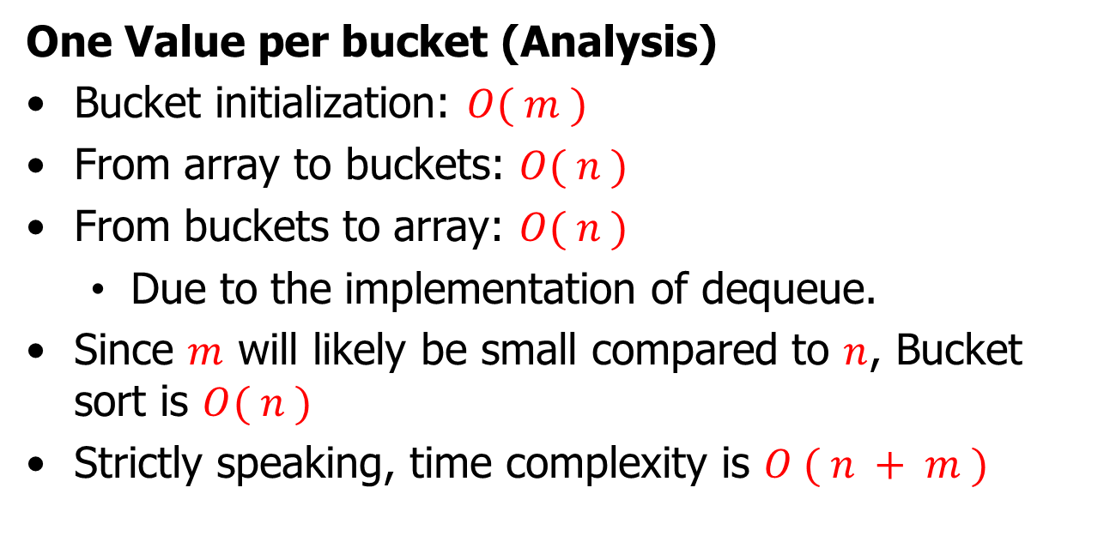
Bucket Sort
One Value per bucket (Analysis)
Bucket initialization: $O( m )$
From array to buckets: $O( n )$
From buckets to array: $O( n )$
Due to the implementation of dequeue.
Since $m$ will likely be small compared to $n$, Bucket sort is $O( n )$
Strictly speaking, time complexity is $O ( n + m )$

Slide 33
Bucket Sort
Multiple items per bucket:
.20 | .12 | .52 | .63 | .64 | .36 | .37 | .47 | .58 | .18 | .88 | .09 | .99
0 | 1 | 2 | 3 | 4 | 5 | 6 | 7 | 8 | 9

Slide 34
Bucket Sort
Multiple items per bucket:
.20 | .12 | .52 | .63 | .64 | .36 | .37 | .47 | .58 | .18 | .88 | .09 | .99
 |  | .20
0 | 1 | 2 | 3 | 4 | 5 | 6 | 7 | 8 | 9

Slide 35
Bucket Sort
Multiple items per bucket:
.20 | .12 | .52 | .63 | .64 | .36 | .37 | .47 | .58 | .18 | .88 | .09 | .99
 | .12 | .20
0 | 1 | 2 | 3 | 4 | 5 | 6 | 7 | 8 | 9

Slide 36
Bucket Sort
Multiple items per bucket:
.20 | .12 | .52 | .63 | .64 | .36 | .37 | .47 | .58 | .18 | .88 | .09 | .99
 | .12 | .20 |  |  | .58
0 | 1 | 2 | 3 | 4 | 5 | 6 | 7 | 8 | 9

Slide 37
Bucket Sort
Multiple items per bucket:
.20 | .12 | .52 | .63 | .64 | .36 | .37 | .47 | .58 | .18 | .88 | .09 | .99
 | .12 | .20 |  |  | .58 | .64
0 | 1 | 2 | 3 | 4 | 5 | 6 | 7 | 8 | 9

Slide 38
Bucket Sort
Multiple items per bucket:
.20 | .12 | .52 | .63 | .64 | .36 | .37 | .47 | .58 | .18 | .88 | .09 | .99
 |  |  |  |  |  | .63
 | .12 | .20 |  |  | .58 | .64
0 | 1 | 2 | 3 | 4 | 5 | 6 | 7 | 8 | 9

Slide 39
Bucket Sort
Multiple items per bucket:
.20 | .12 | .52 | .63 | .64 | .36 | .37 | .47 | .58 | .18 | .88 | .09 | .99
 |  |  |  |  |  | .63
 | .12 | .20 | .36 |  | .58 | .64
0 | 1 | 2 | 3 | 4 | 5 | 6 | 7 | 8 | 9

Slide 40
Bucket Sort
Multiple items per bucket:
.20 | .12 | .52 | .63 | .64 | .36 | .37 | .47 | .58 | .18 | .88 | .09 | .99
 |  |  | .37 |  |  | .63
 | .12 | .20 | .36 |  | .58 | .64
0 | 1 | 2 | 3 | 4 | 5 | 6 | 7 | 8 | 9

Slide 41
Bucket Sort
Multiple items per bucket:
.20 | .12 | .52 | .63 | .64 | .36 | .37 | .47 | .58 | .18 | .88 | .09 | .99
 |  |  | .37 |  |  | .63
 | .12 | .20 | .36 | .47 | .58 | .64
0 | 1 | 2 | 3 | 4 | 5 | 6 | 7 | 8 | 9

Slide 42
Bucket Sort
Multiple items per bucket:
.20 | .12 | .52 | .63 | .64 | .36 | .37 | .47 | .58 | .18 | .88 | .09 | .99
 |  |  | .37 |  | .58 | .64
 | .12 | .20 | .36 | .47 | .52 | .63
0 | 1 | 2 | 3 | 4 | 5 | 6 | 7 | 8 | 9

Slide 43
Bucket Sort
Multiple items per bucket:
.20 | .12 | .52 | .63 | .64 | .36 | .37 | .47 | .58 | .18 | .88 | .09 | .99
 | .18 |  | .37 |  | .58 | .64
 | .12 | .20 | .36 | .47 | .52 | .63
0 | 1 | 2 | 3 | 4 | 5 | 6 | 7 | 8 | 9

Slide 44
Bucket Sort
Multiple items per bucket:
.20 | .12 | .52 | .63 | .64 | .36 | .37 | .47 | .58 | .18 | .88 | .09 | .99
 | .18 |  | .37 |  | .58 | .64
 | .12 | .20 | .36 | .47 | .52 | .63 |  | .88
0 | 1 | 2 | 3 | 4 | 5 | 6 | 7 | 8 | 9

Slide 45
Bucket Sort
Multiple items per bucket:
.20 | .12 | .52 | .63 | .64 | .36 | .37 | .47 | .58 | .18 | .88 | .09 | .99
 | .18 |  | .37 |  | .58 | .64
.09 | .12 | .20 | .36 | .47 | .52 | .63 |  | .88
0 | 1 | 2 | 3 | 4 | 5 | 6 | 7 | 8 | 9

Slide 46
Bucket Sort
Multiple items per bucket:
.20 | .12 | .52 | .63 | .64 | .36 | .37 | .47 | .58 | .18 | .88 | .09 | .99
 | .18 |  | .37 |  | .58 | .64
.09 | .12 | .20 | .36 | .47 | .52 | .63 |  | .88 | .99
0 | 1 | 2 | 3 | 4 | 5 | 6 | 7 | 8 | 9

Slide 47
Bucket Sort
Multiple items per bucket:
.20 | .12 | .52 | .63 | .64 | .36 | .37 | .47 | .58 | .18 | .88 | .09 | .99
 | .18 |  | .37 |  | .52 | .63
.09 | .12 | .20 | .36 | .47 | .58 | .64 |  | .88 | .99
0 | 1 | 2 | 3 | 4 | 5 | 6 | 7 | 8 | 9

Slide 48
Bucket Sort
Multiple items per bucket:
.20 | .12 | .52 | .63 | .64 | .36 | .37 | .47 | .58 | .18 | .88 | .09 | .99
 | .18 |  | .37 |  | .58 | .64
.09 | .12 | .20 | .36 | .47 | .52 | .63 |  | .88 | .99
0 | 1 | 2 | 3 | 4 | 5 | 6 | 7 | 8 | 9
Apply Internal sorting(stable)

Slide 49
Bucket Sort
Multiple items per bucket:
.20 | .12 | .52 | .63 | .64 | .36 | .37 | .47 | .58 | .18 | .88 | .09 | .99
 | .18 |  | .37 |  | .52 | .63
.09 | .12 | .20 | .36 | .47 | .58 | .64 |  | .88 | .99
0 | 1 | 2 | 3 | 4 | 5 | 6 | 7 | 8 | 9

Slide 50
Bucket Sort
Multiple items per bucket:
.20 | .12 | .52 | .63 | .64 | .36 | .37 | .47 | .58 | .18 | .88 | .09 | .99
 | .18 |  | .37 |  | .52 | .63
.09 | .12 | .20 | .36 | .47 | .58 | .64 |  | .88 | .99
0 | 1 | 2 | 3 | 4 | 5 | 6 | 7 | 8 | 9
.09 | .12 | .18 | .20 | .36 | .37 | .47 | .52 | .58 | .63 | .64 | .88 | .99

Slide 51
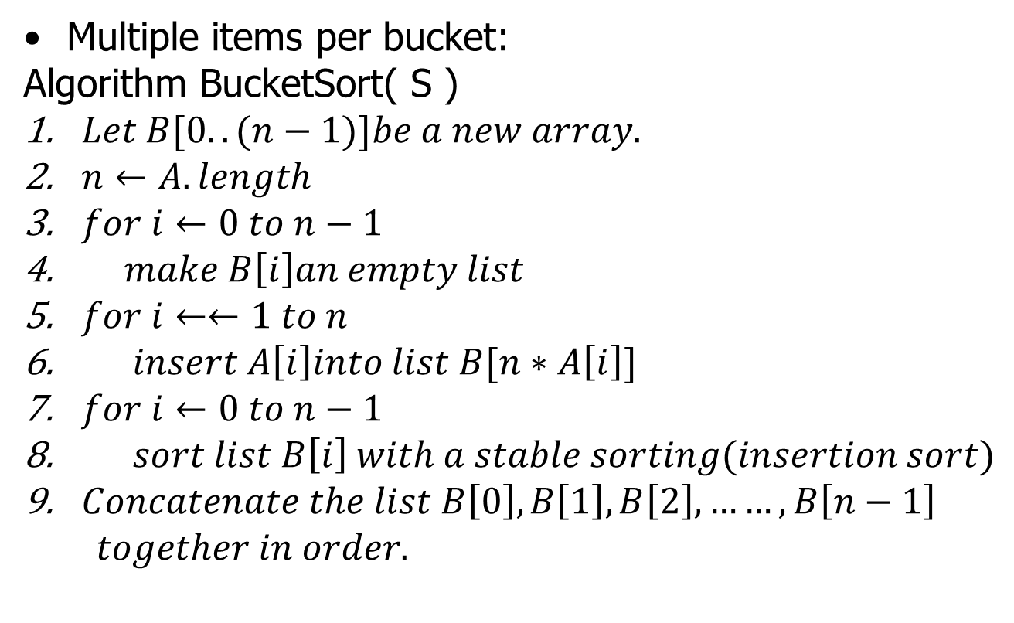
Bucket Sort
Multiple items per bucket:
Algorithm BucketSort( S )
$Let B[0..(n−1)]be a new array.$
$n←A. length$
$for i←0 to n−1$
$make B\left[i\right]an empty list$
$for i←←1 to n$
$insert A\left[i\right]into list B[n∗A\left[i\right]]$
$for i←0 to n−1$
$sort list B\left[i\right] with a stable sorting(insertion sort)$
$Concatenate the list B\left[0\right], B\left[1\right], B\left[2\right],……,B\left[n−1\right]$
$together in order.$

Slide 52
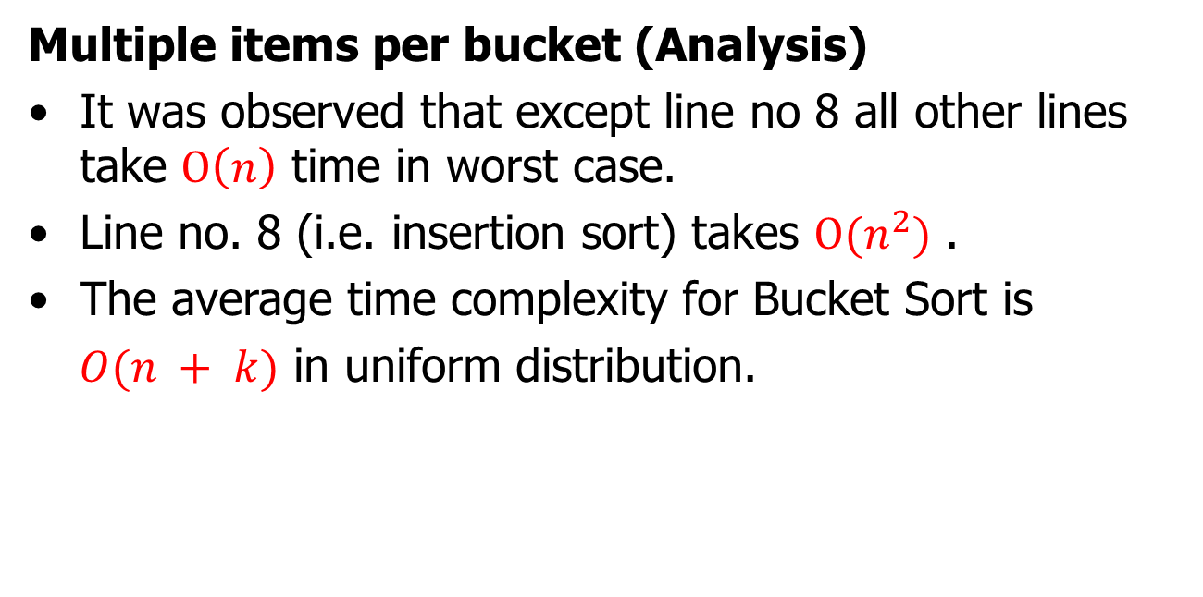
Bucket Sort
Multiple items per bucket (Analysis)
It was observed that except line no 8 all other lines take $Ο\left(n\right)$ time in worst case.
Line no. 8 (i.e. insertion sort) takes $Ο(n^{2})$ .
The average time complexity for Bucket Sort is
$O(n + k)$ in uniform distribution.

Slide 53
Bucket Sort
Characteristics of Bucket Sort
Bucket sort assumes that the input is drawn from a uniform distribution.
The computational complexity estimates involve the number of buckets.
Bucket sort can be exceptionally fast because of the way elements are assigned to buckets, typically using an array where the index is the value.

Slide 54
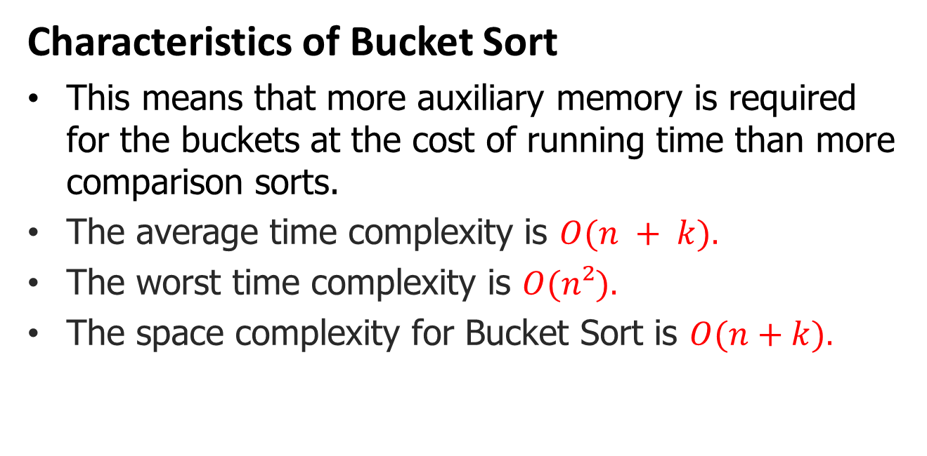
Bucket Sort
Characteristics of Bucket Sort
This means that more auxiliary memory is required for the buckets at the cost of running time than more comparison sorts.
The average time complexity is $O(n + k).$
The worst time complexity is $O(n²).$
The space complexity for Bucket Sort is $O(n+k).$

Slide 55

Thank U

